Slide 1
South East Association of Directors of Adult Social Services
(SE ADASS)
Presentation for SE Improving System Flow Group
April 2025
Robyn Noonan
Programme Director, SE ADASS
robyn.noonan@oxfordshire.gov.uk

Slide 2
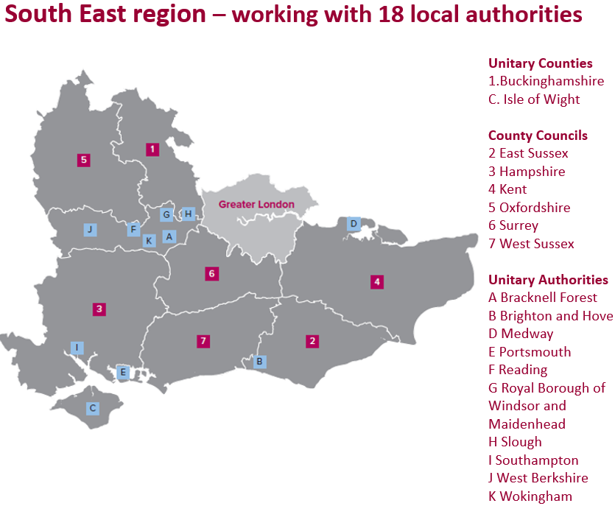
Local Government in the SE – Adult Social Care
In the SE we currently have a mixture of two-tier and unitary areas with responsibility for adult social care (ASC). In a two-tier council area, the district/borough council is responsible for housing whilst ASC sits within the county responsibilities. Unitary councils are responsible for both housing and ASC.

Slide 3
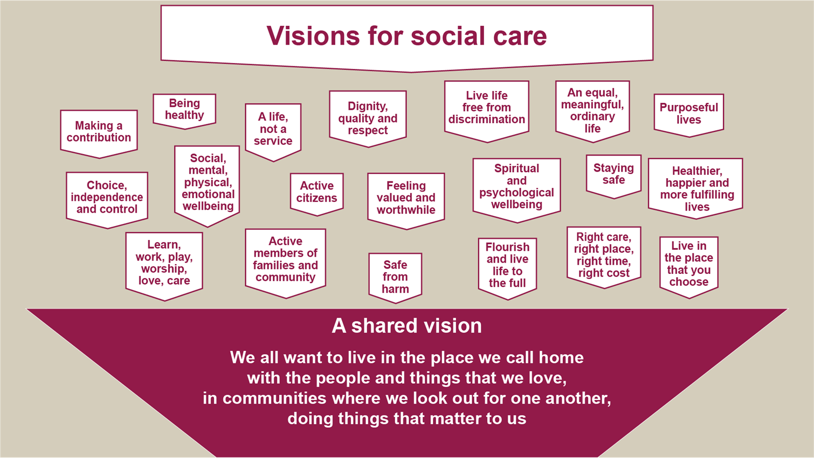
ADASS Vision for Adult Social Care …… what ASC supports people to achieve every day
#SocialCareFuture - Home - Social Care Future

Slide 4
The Economic Case for Adult Social Care
The most recent data from Skills for Care* estimates that there are 270,000 filled posts in the adult social care sector in the South East.
Social care contributes over £50bn to the UK economy.
FSCC Carenomics
For every £1 invested, it generates £1.75
‘Future Social Care Coalition’.
The economic contribution of social care in the South East is considerable: with Gross Value Added (GVA) estimated at £8,310 million – the largest figure for any English region.
* Skills for Care Adult Social Care Workforce Data Set - Regional summaries 2024 - South East
As of 31 December 2024:
97,000 people were accessing long term support in the community in the South East region
Adult social care in England, monthly statistics: April 2025 - GOV.UK

Slide 5
Adult Social Care Key Statutory Duties
Adult Social Care is responsible for …………….
Care Act 2014
Mental Capacity Act 2005
Mental Health Act 2007
Human Rights Act 1998
Children & Families Act 2014 – 0-25yrs
Note: hospital discharge represents 19% of adult social care total statutory activities in the South East region

Slide 6
Adult Social Care Key Statutory Duties – CARE ACT 2014
Care Act Statutory Activity
Information & advice signposting
Assessing needs & ensuring availability & delivery of services
Assessment & support to family carers
Support wellbeing
Safeguarding & Making Safeguarding Personal
Improving preventative services, delivering earlier intervention, greater choice and control & promoting independence.
Tackling inequalities & improving access to services.
Market shaping & ensuring continuity of care.
Charging for care

Slide 7
Adult Social Care - CARE ACT – Eligibility & Outcomes
Adults’ needs are eligible where they meet all three conditions:
The adult’s needs arise from a long term condition related to a physical or mental impairment or illness
As a result of the needs, the adult is unable to achieve two or more of the outcomes specified
As a consequence, there is significant impact of adult’s wellbeing
Outcomes
managing and maintaining nutrition
maintaining personal hygiene
managing toilet needs
being appropriately clothed
being able to make use of the adult’s home safely
maintaining a habitable home environment
developing and maintaining family or other personal relationships
accessing and engaging in work, training, education or volunteering
making use of necessary local facilities or services
carrying out any caring responsibilities the adult has for a child
What is Wellbeing?
Personal dignity
Physical, mental & emotional wellbeing
Protection from abuse and neglect
Control over day-to-day life
Participation in work, education, training or recreation
Social and economic wellbeing
Domestic, family and personal
Suitability of living accommodation
The individual’s contribution to society

Slide 8
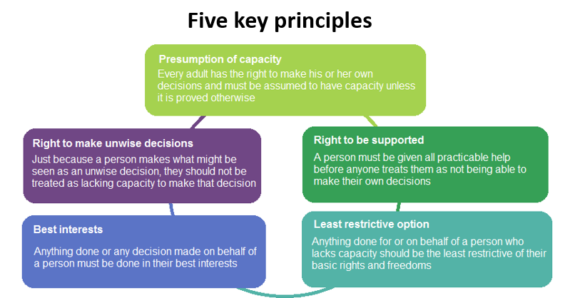
Adult Social Care Key Statutory Duties - Mental Capacity Act
Deprivation of Liberty
Currently 3 ways to authorise deprivation of liberty
Detention under the Mental Health Act
Authorisation under Deprivation of Liberty Safeguards (DoLS)
Order from the Court of Protection
Whenever a decision is being made about an individual’s care and health, it is important that the professionals involved have considered the individual’s mental capacity to make the decision and where necessary, a mental capacity assessment should be carried out. The person who will implement the decision is responsible for assessing mental capacity.

Slide 9
Adult Social Care Key Statutory Duties - Mental Health Act
AMHPs are employed by the LA
s117 Mental Health Act
Approved Mental Health Professionals (AMHPs) employed by the LA have a key statutory role in the effective delivery of mental health services.
AMHPs lead the co-ordination of statutory mental health assessments under the MHA.
They are responsible for organising the assessment, identification of the Nearest Relative and organising doctors and key agencies, such as police & ambulance.
AMHPs are independently responsible for a decision to detain a person and arrange conveyance to hospital.
AMHPs have a key responsibility to ensure people’s human rights are upheld and that the guiding principles of the MHA are followed.
The right to receive s117 aftercare applies to people who have been detained in hospital for treatment, who then cease to be detained and leave hospital, provided they were detained under one of the following provisions of the MHA: s3; s37 and s45a; s47 and s48
Section 117 places a joint duty on the NHS and the local authority to provide aftercare services that the person is assessed to need to prevent further hospital admissions.

Slide 10
What are some of the things that Adult Social Care (ASC) isn’t responsible for that can confuse our partners……
Adult social care primarily focuses on helping people to stay well and independent for as long as possible at home in their community/ neighbourhood. There are certain areas and responsibilities that adult social care does not cover:
Crisis Intervention: crisis intervention services are usually provided by specialised mental health crisis teams or emergency services
Housing/ Homelessness Services: ASC may work closely with housing services (e.g. developing extra care housing/ supported living) to ensure individuals have suitable living conditions but it doesn’t directly provide housing or manage housing services
Primary health support: continuing healthcare & delegated healthcare is the responsibility of the NHS. ASC will deliver delegated healthcare with the correct governance and accountabilities in place
Financial Assistance: Whilst ASC may help with financial assessments and managing payments for care services, it does not provide benefits. These are managed by other government departments.
Substance misuse: treatment for addiction

Slide 11

Case Studies for Discussion
Relevant Legislation
Does the person have Care Act needs?
Does CD have mental capacity to understand his care and support needs & the choice to drink alcohol & understand the risks to him? Does DoLs apply?
Right to family life under the Human Rights Act
Case Study 1
A man CD of working age with a brain injury, having his seventh child, recently released from a short prison stay. On release from prison, CD starts drinking binges again at which time he disappears for days and is often found collapsed in the street and an ambulance is called by a member of the public. CD is regularly presenting at the acute hospital via ambulance and getting ‘stuck’ in hospital as he is refusing any support & hospital discharge team feel it is unsafe to send him home without support. CD has had two episodes of funded rehabilitation, and the addiction services are reluctant to offer him a third whilst he says he will continue to drink. At the time there were only two ‘wet’ care homes, both in London with poor CQC ratings which he refused for a period of assessment.
Acute hospital response
There was nothing the acute hospital could offer CD on each admission once he was sober, and he didn’t meet the criteria for MH crisis intervention
The hospital wanted the community to act to prevent further admissions
The hospital assessed CD as not having capacity to understand his care & support needs and wanted social care to ‘place’ him somewhere with a locked door
Adult Social Care (ASC) Response
CD was assessed as not having Care Act needs but difficult to hold him anywhere long enough to assess properly
CD has his own flat to return to and ASC can’t send someone to a care home that ‘requires improvement’. He was choosing to go home
CD was assessed as having capacity to understand his care & support needs and would not meet the threshold for a mental health detention & DoLs doesn't apply
ASC are required to appoint an advocate and refer the mental capacity decision to the Court of Protection – where there was a 9 month delay. The health & social care professionals would have to defend their MCA assessment in court
The only legal powers adult social care have - Care Act, Mental Capacity Act and Mental Health Act
Does CD have a right to further rehabilitation if he agreed to stop drinking?

Slide 12
Case Studies for Discussion
Case Study 2
Relevant legislation
Does the person have Care Act needs?
Does AP have mental capacity to understand his care and support needs? Does DoLs apply?
Would he meet the Mental Health Act detention threshold or the Community Mental Health Team support threshold?
Duty to refer for housing - A guide to the duty to refer - GOV.UK
Is AP a priority for housing? Does he need an advocate?
An older man AP who served in the armed forces is ‘street’ homeless suffering from anxiety, depression and poor physical health. AP has no living family. He is very angry, displaying anti-social behaviour and unwilling to accept support as he described a lack of trust of public services. He is admitted to hospital following an assault. When planning for discharge it was discovered he was ‘intentionally homeless’ - Homelessness code of guidance for local authorities - Chapter 9: Intentional homelessness - Guidance - GOV.UK. He was encouraged to accept the offers of extra care housing or a temporary stay in a registered care home to create more time to successfully plan for his care act needs and he refused. He would not accept support from SSAFA, the armed forces charity.
Acute hospital response
Discharge planning discovered that AP was ‘intentionally’ homeless.
If AP has Care Act eligible needs, why is he still in hospital?
Does AP really have mental capacity to understand his care and support needs
AP did not meet the threshold for support from the Community Mental Health Team
AP could not register with a GP as he did not have an address. He could access the GP homelessness service but had to get there.
Health and social care discharge team understandably felt very uncomfortable discharging anyone to a homeless shelter/ ‘street’ homelessness.
Adult social care (ASC) response
AP was assessed to have Care Act eligible needs
AP was assessed to have mental capacity to decide how his care and support needs should be met. He refused the offer of support of emergency ECH or temporary care home and an advocate. ASC had no power to deprive him of his liberty (DoLs)
AP did not meet the threshold for a Mental Health Act detention
AP was not eligible for housing so ASC couldn’t meet their duty without somewhere for him to live

