Slide 1
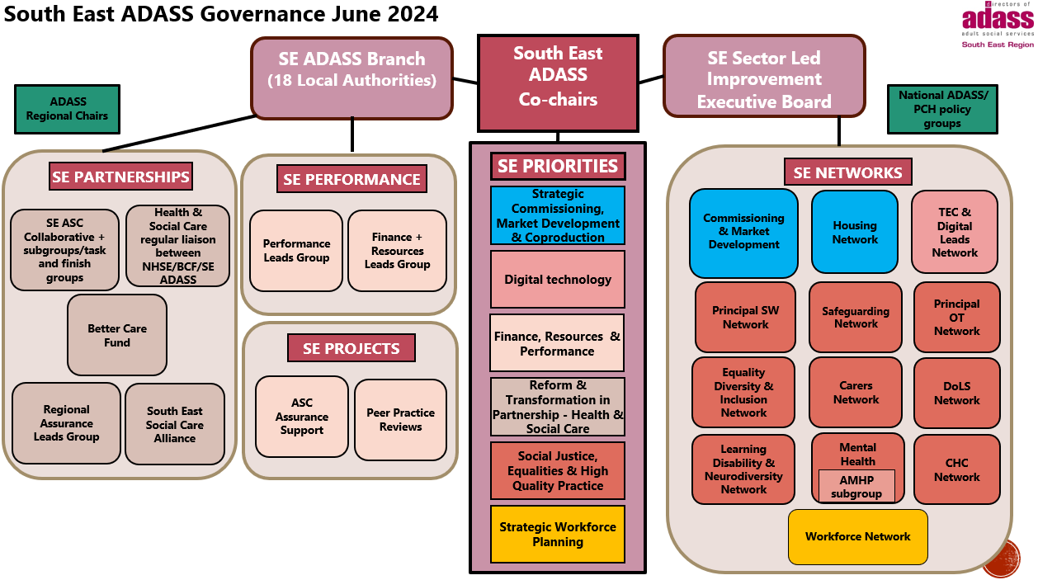
Achieving our vision and priority objectives

